Slide 1
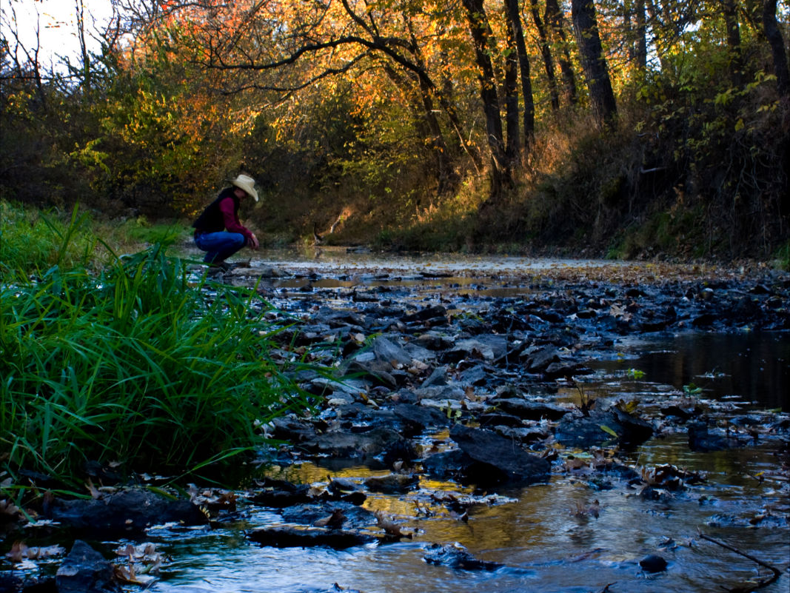
Welcome to HCC’s KLINEFELTER FARM
A Living Classroom

Slide 2
THE KLINEFELTER FAMILY LEGACY
John and Gloria Klinefelter, children of John S. and Elizabeth Klinefelter, grew up on this farm and by their later years, it had been farmed by three generations of their family for over 100 years. Thus, it became known as the Klinefelter Century Farm.
Neither John nor Gloria had children, and they both became very generous benefactors, not only to Highland Community College, but to many other charities and individuals. John left 640 acres to the college, 160 acres in Doniphan Co. which could be sold for the college’s benefit, and 480 acres in Brown Co. to be “operated as a regular commercial farm for the education and training of those individuals seeking a vocation in farming. A portion thereof may be devoted to experimental or other farm purposes.”
John & Gloria Klinefelter

Slide 3
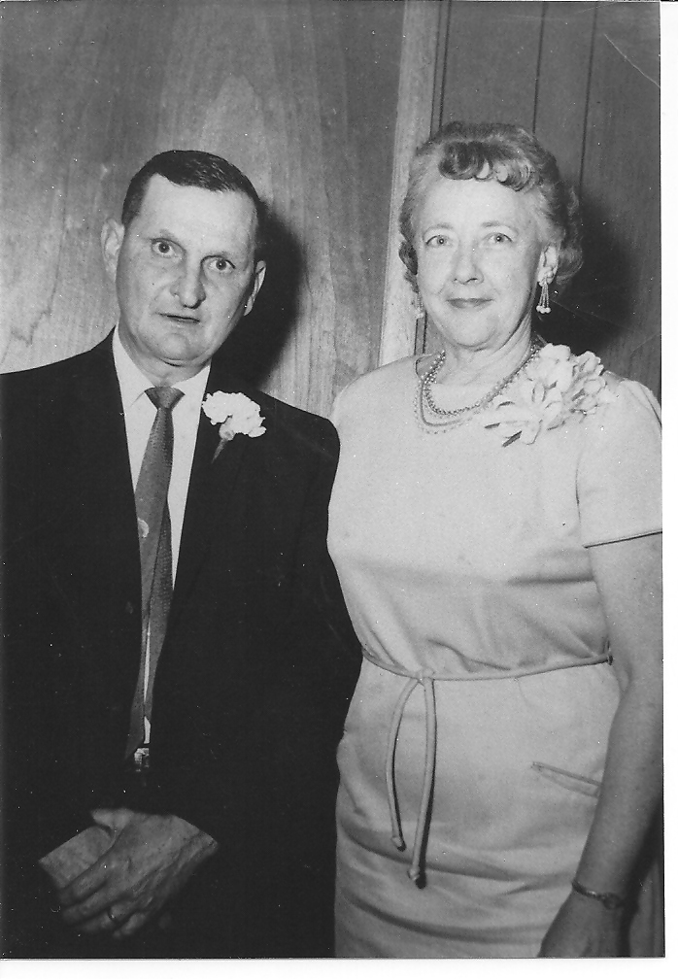
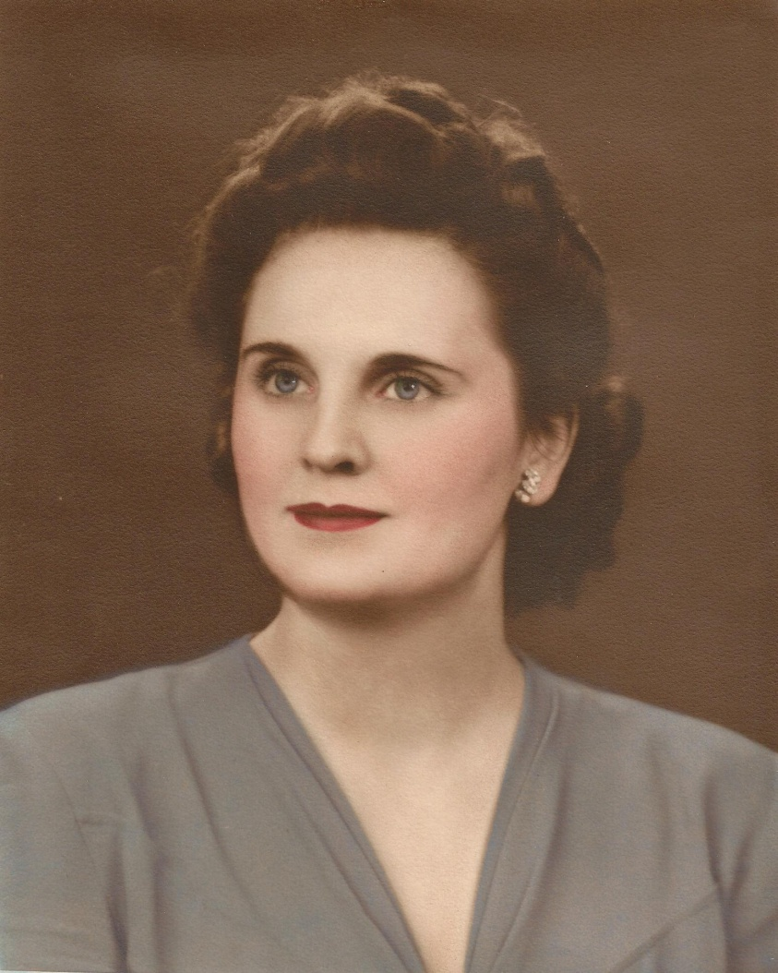
Gloria Klinefelter Plamann
John & Maree
Klinefelter

Slide 4
Our Location
The Klinefelter Farm is located two miles east of Hiawatha, KS just off the Mulberry Rd. exit on U.S. 36 Highway. The farm headquarters is located 2/3 mi. east of the Mulberry Rd. corner on 230th St. It is bounded on the east by Nighthawk Rd. and on the north by Old 36 Highway. The 480 acre farm is an L-shaped piece formed by three quarter sections out of a square mile.

Slide 5
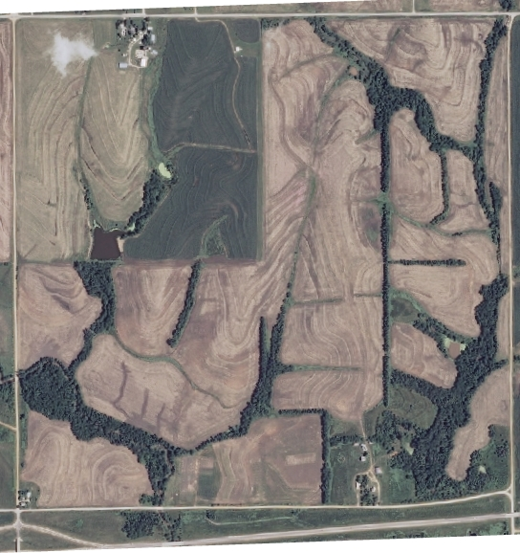
240TH St. (Old 36 Highway)
Mulberry
Road
Nighthwk
Road
KLINEFELTER
FARM
230th St.
U.S. 36 Highway

Slide 6
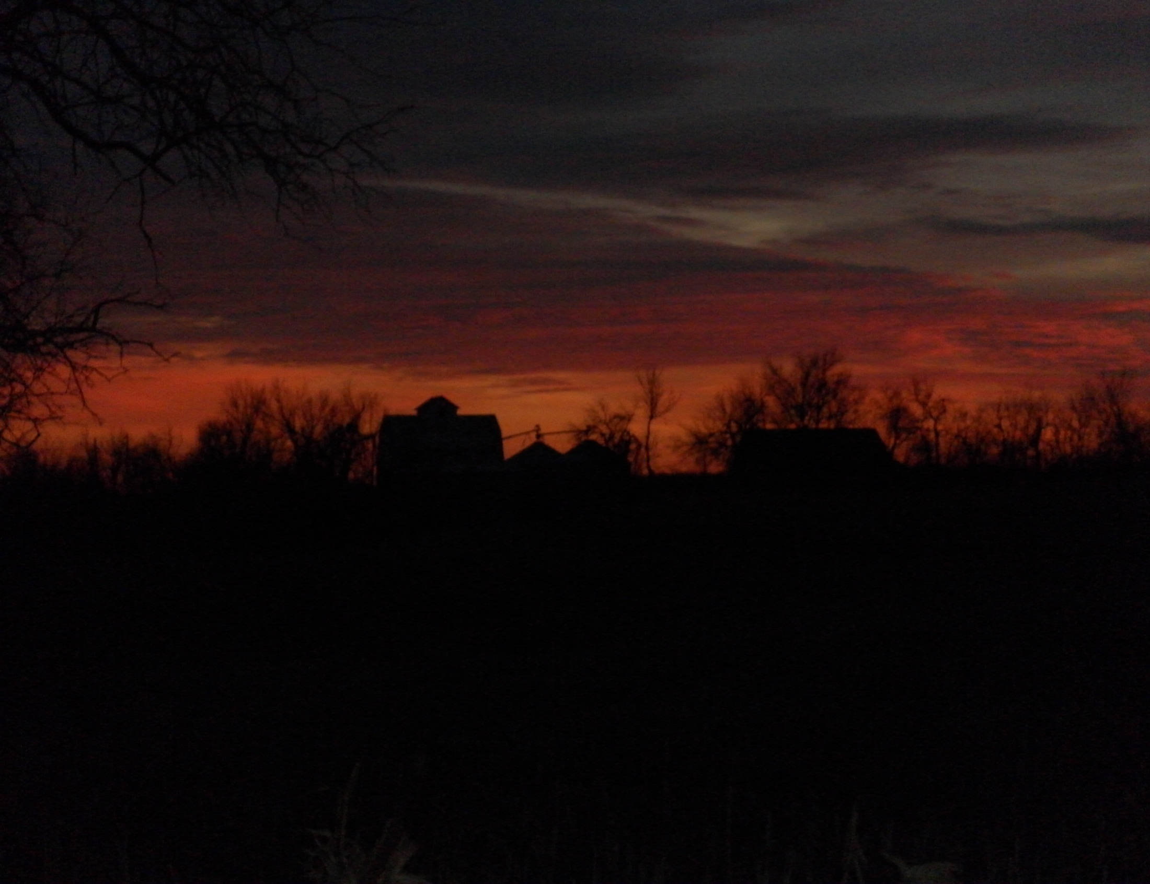
THE KLINEFELTER FARM IS:
a living community of which we are all members;
a member of our extended community of small rural communities and the community college concept;
a living classroom;
an experimental research facility;
a source of income to promote education;
a place to continually seek and find truth about the soil, the plants, and the animals that make up our larger ecosystem;
a place to build a sense of community and culture with our students, our staff, our guests, and the residents of our service area;
a place of rest, relaxation, reflection, and renewal;
an experience for introducing others to our natural environment;
and the soil where seeds of experience grow into future wisdom

Slide 7
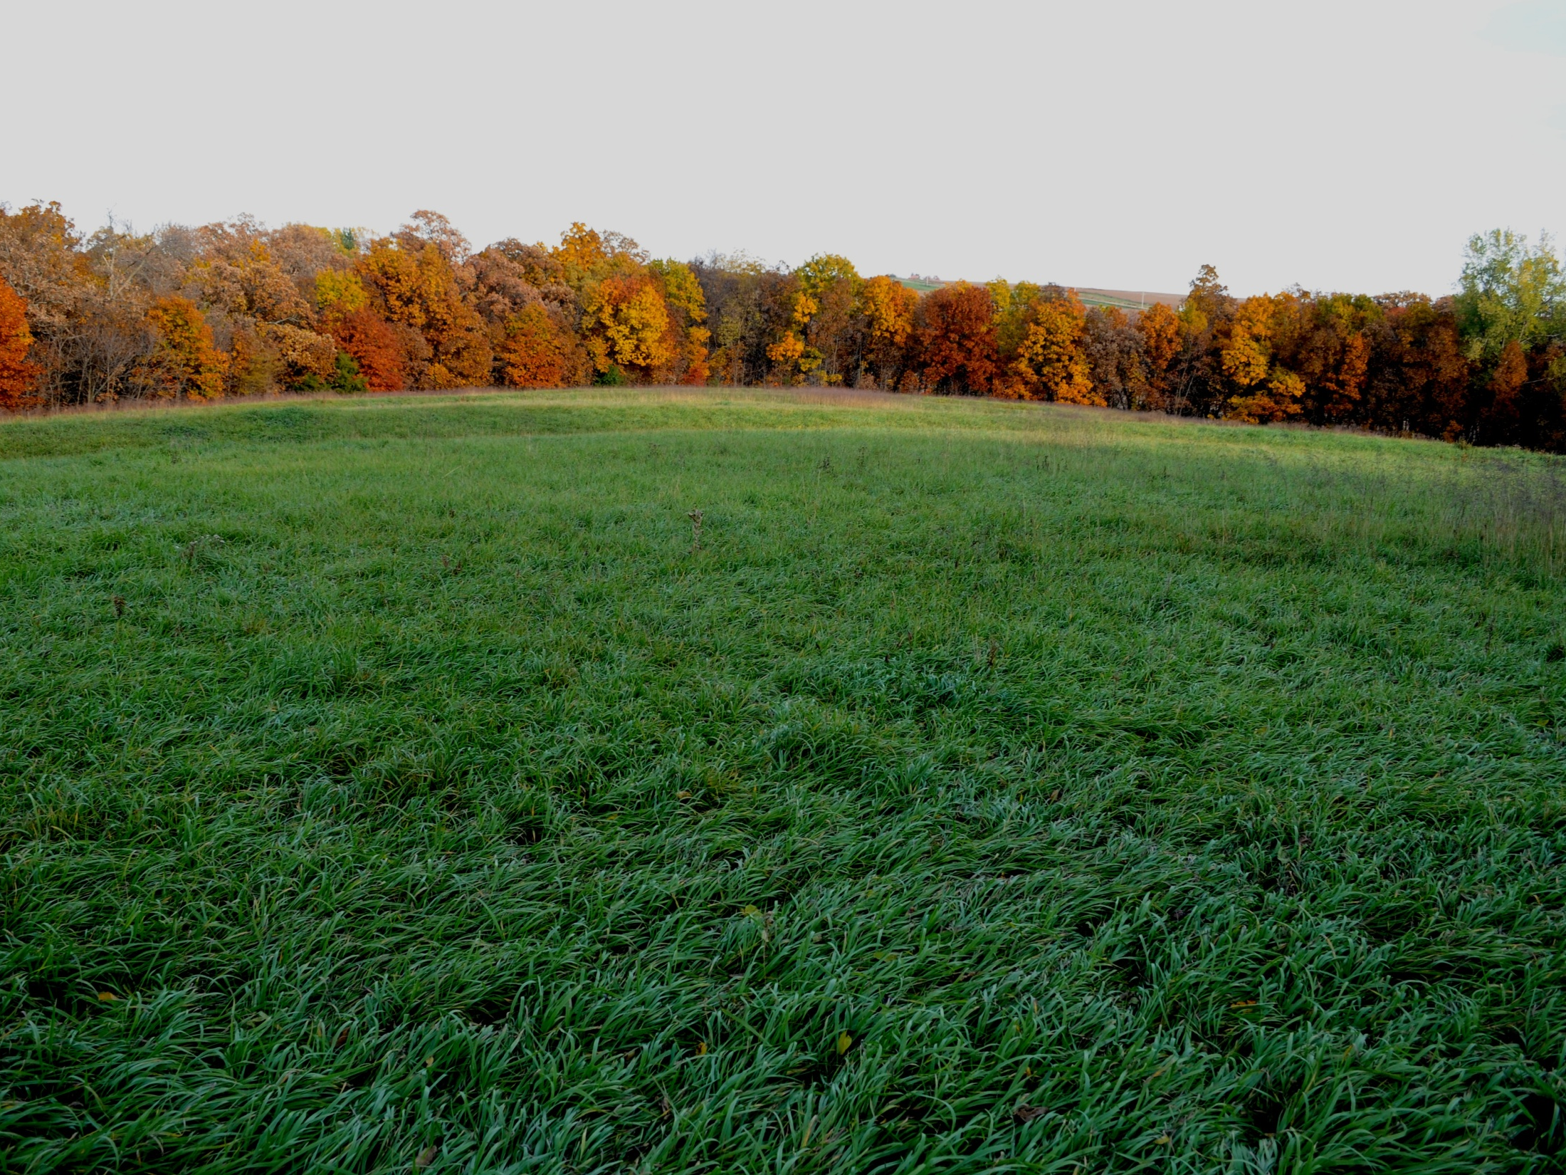
IT IS OUR RESPONSIBILITY TO:
honor the heritage of the Klinefelter family and the tradition of the family farm in rural America;
be good stewards of the land and to provide the opportunities for future sustainability;
elevate the search for knowledge above the quest for monetary gain;
glean wisdom from the past to ensure the greatest quality of life for the future.

Slide 8
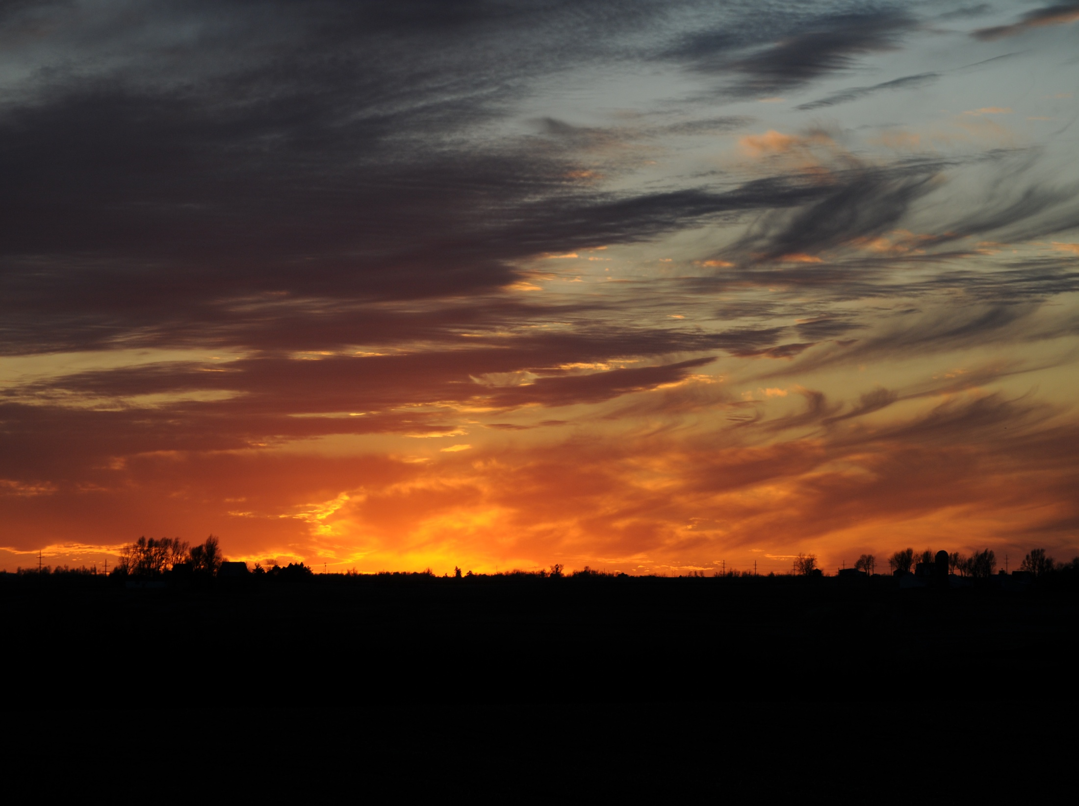
CURRENT FARM PROJECTS
Ropes course
Trail system
Campgrounds
Research plots
KSU
Land Institute
Native American
heirloom seeds
Chuck wagon
Conference center
Farm cleanup
Farm office/shop
Quail habitat
Beekeeping
Brown Co. Healthy Food Coalition plots
Class projects/field trips
Klinefelter family research
Hay production
Vineyard/Orchard

Slide 9
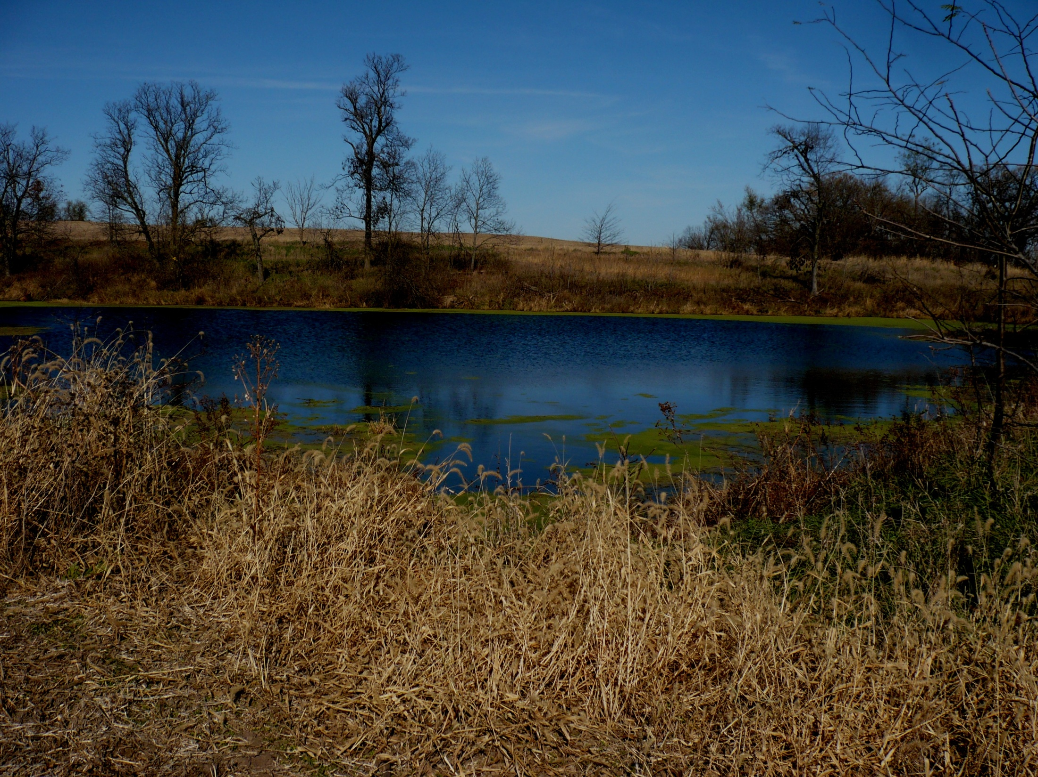
FUTURE FARM PROJECTS
Amphitheatre
Pond improvement
Filter Strips
Native pollinator habitat
Outdoor education lab and classroom
Butterfly house
Greenhouse
Equipment acquisition
Blacksmith shop
Granary and hay barn restoration
Farmstead and pasture fencing
Livestock
Conservation work
Picnic grounds
River Friendly Farm Environmental Assessment

Slide 10
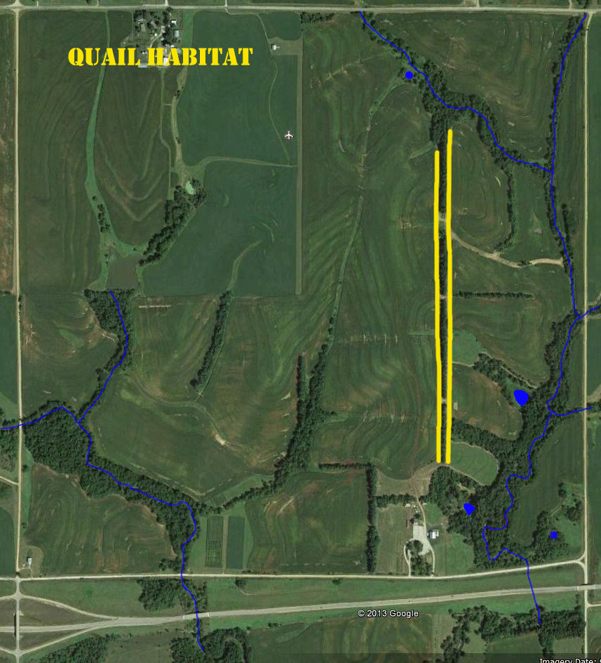
SITE PLAN

Slide 11
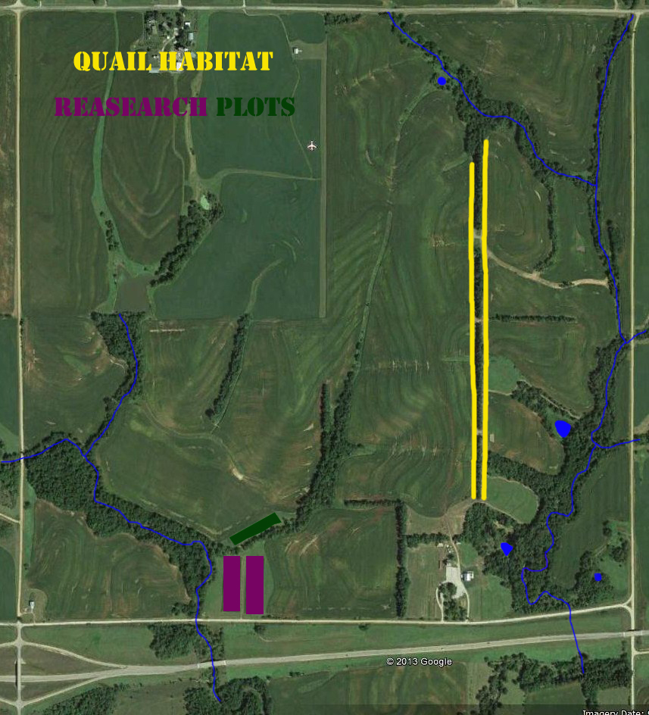
SITE PLAN

Slide 12
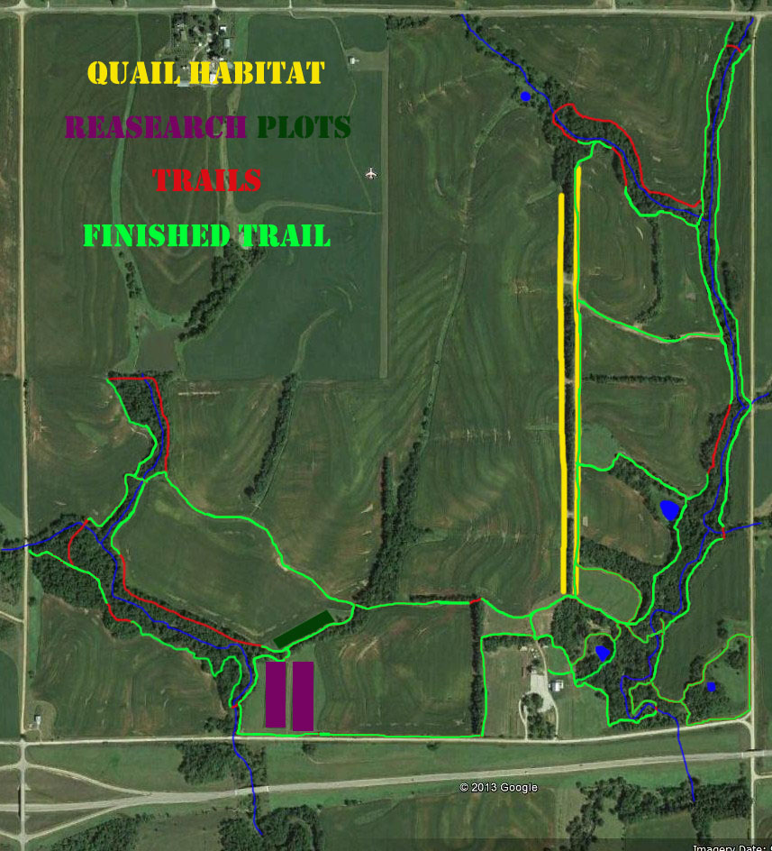
SITE PLAN

Slide 13
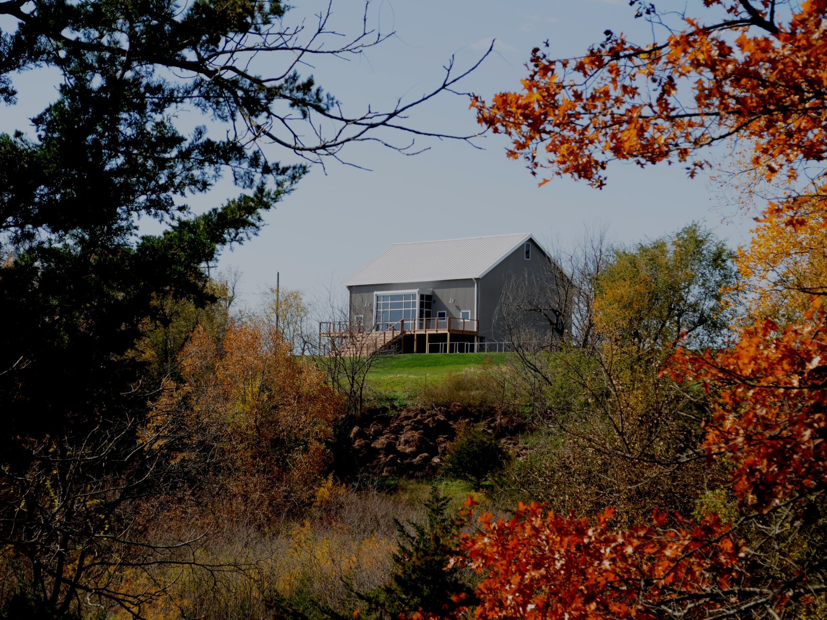
THE BARN CONFERENCE CENTER
Renovation completed in 2012
Funded totally by a gift from the Gloria Plamann Trust and farm income
Winner of 2012 American Institute of Architecture
Kansas City Chapter “Design Hero” award
Used for educational and agricultural meetings
Seating capacity of 130

Slide 14
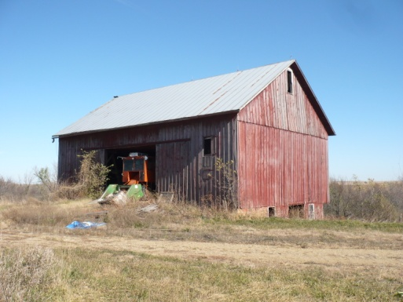
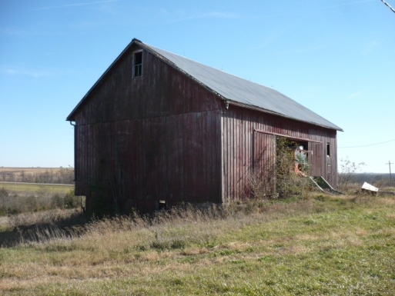
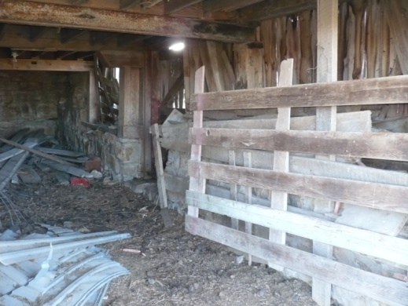
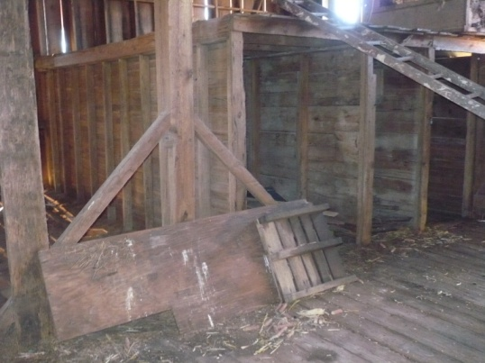
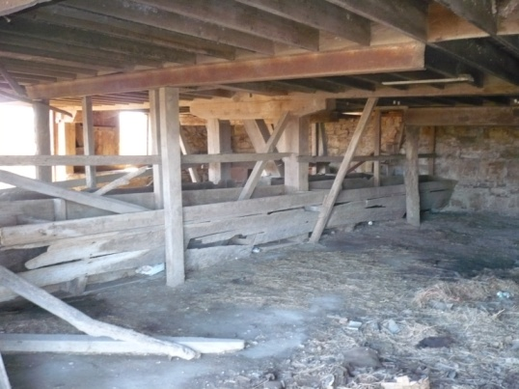
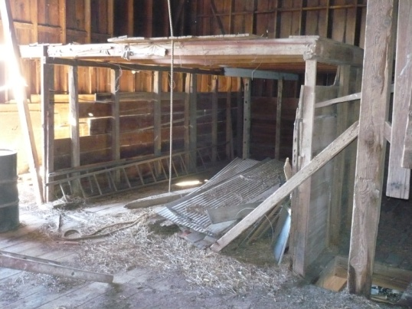
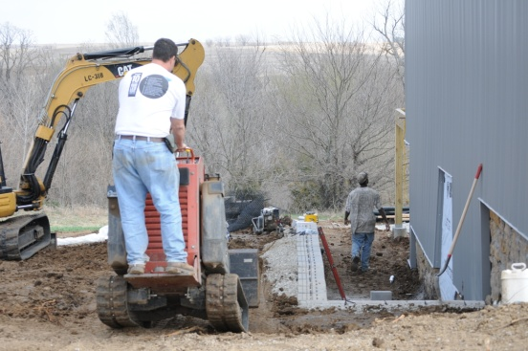
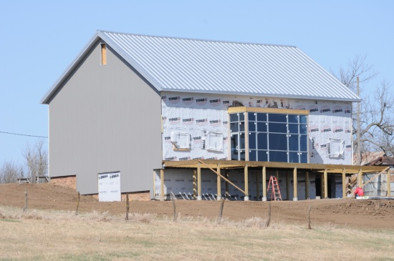
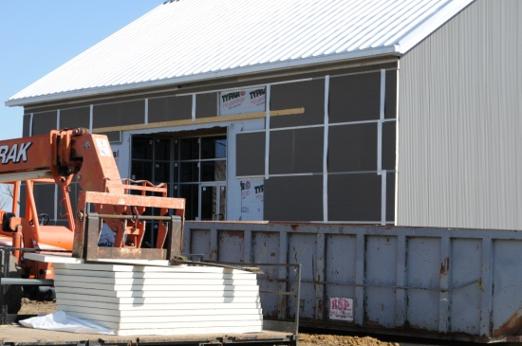
BEFORE

Slide 15
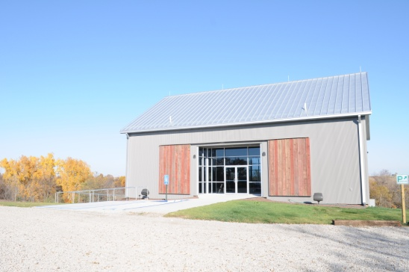
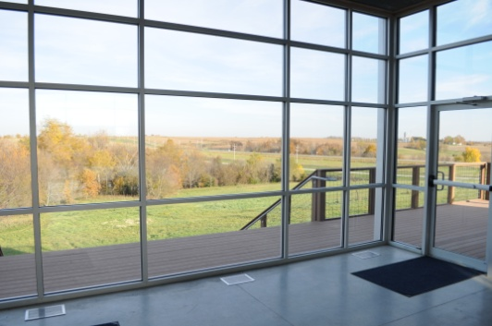
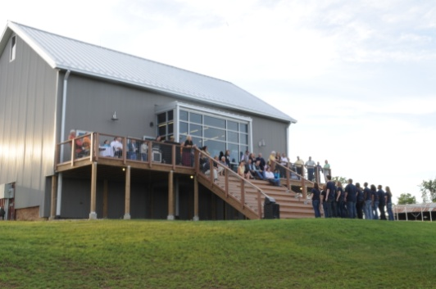
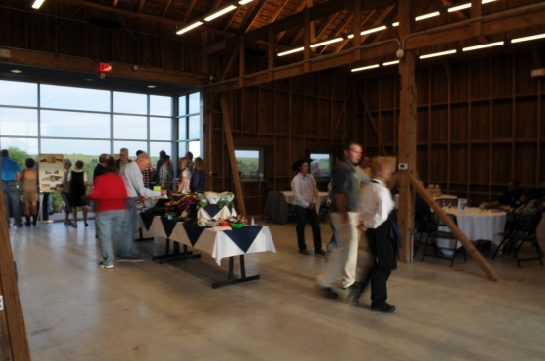
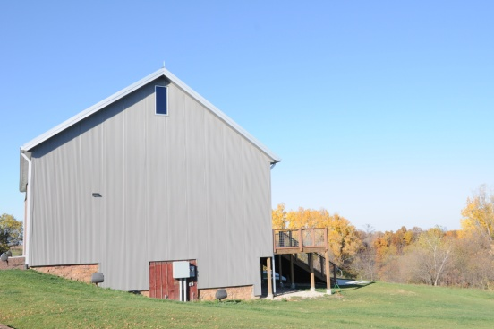
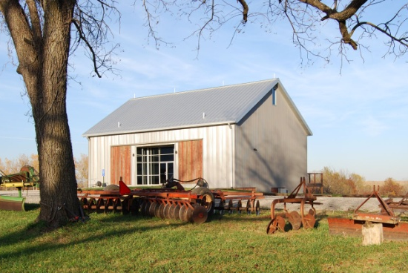
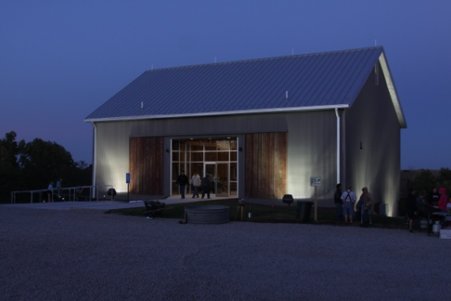
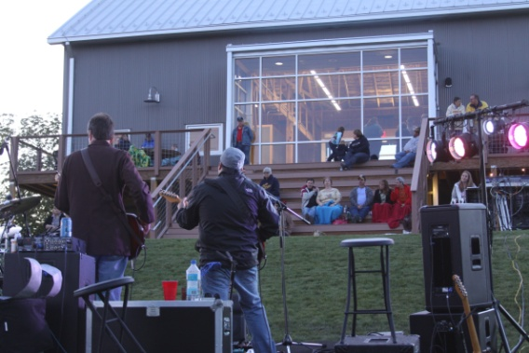
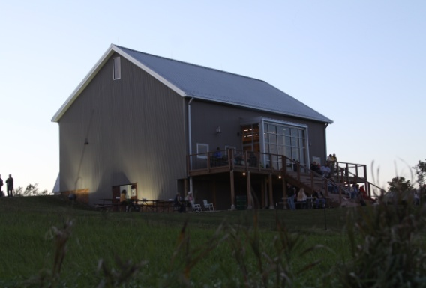
AFTER

Slide 16
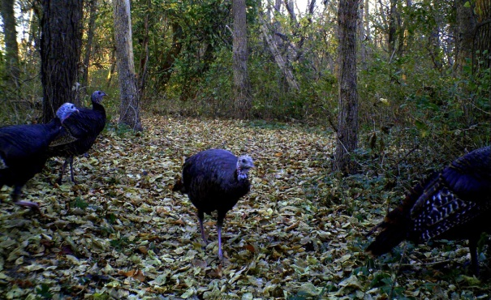
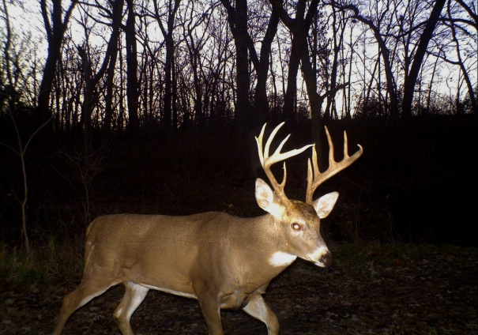
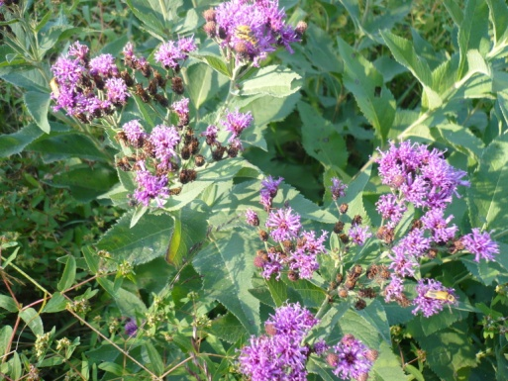
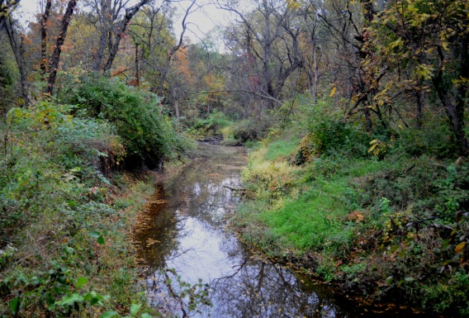
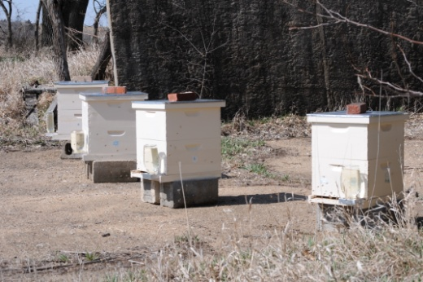
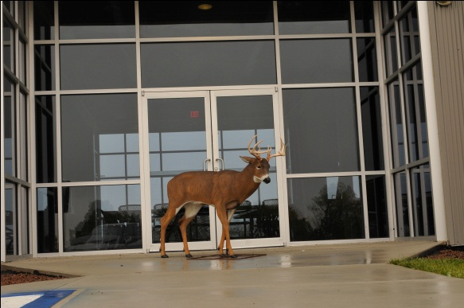
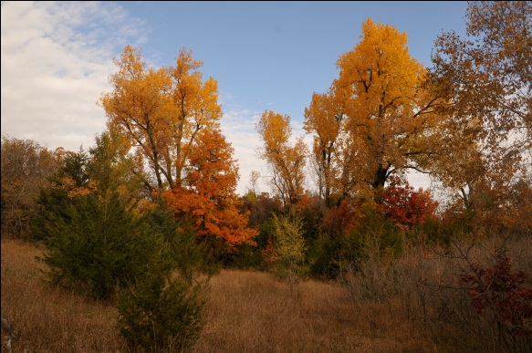
FLORA AND FAUNA

Slide 17
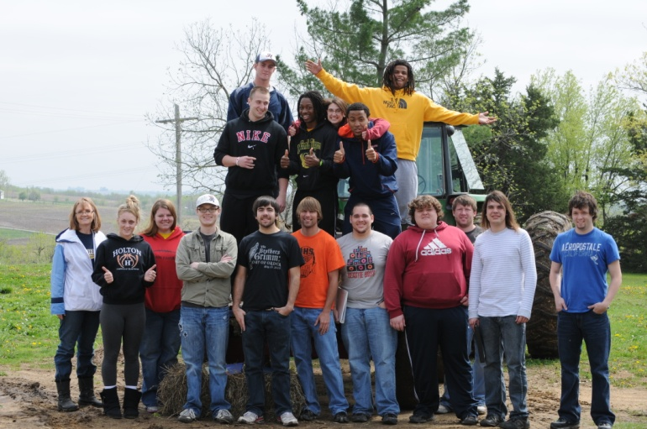
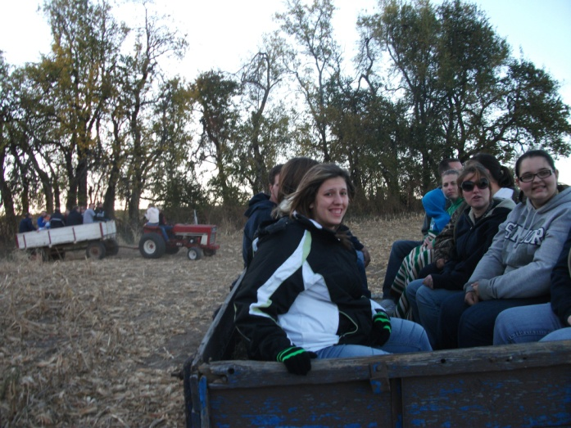
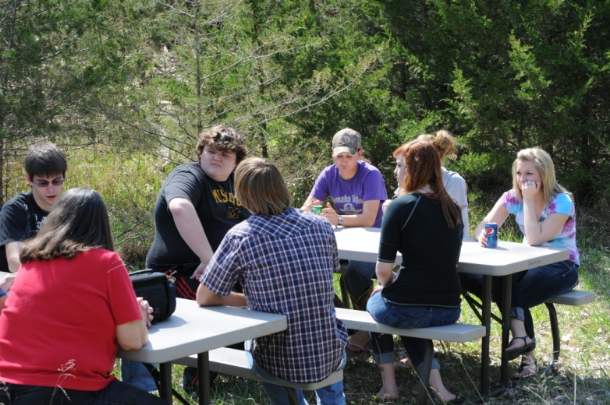
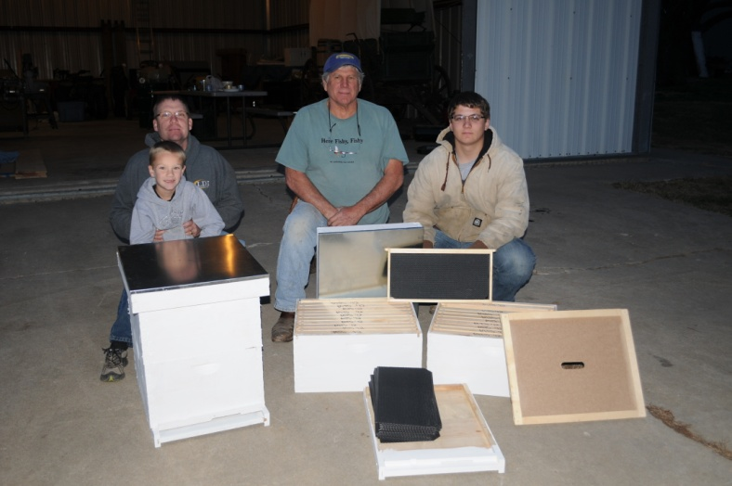
HCC STUDENTS AT THE FARM
Intro to Env. Science Class
SSS Fall Social
Contemporary Issues in
Sustainability Class
Beekeeping Equip. Construction

Slide 18
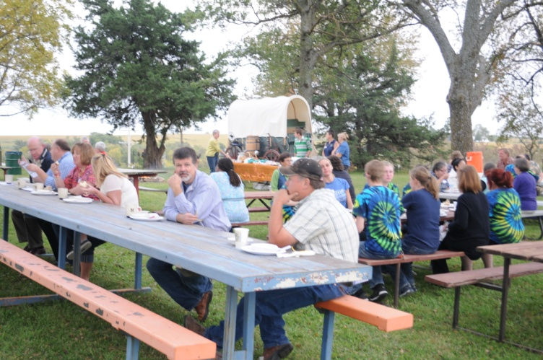
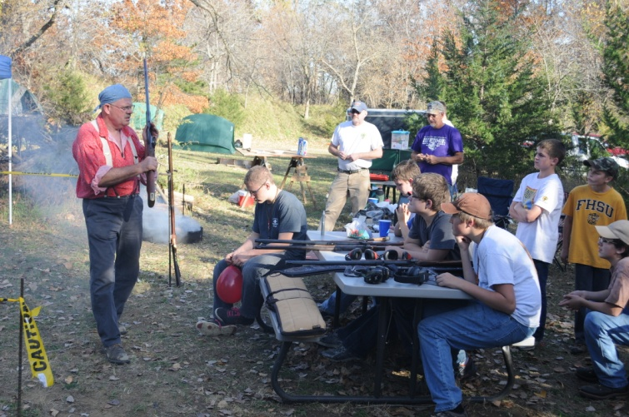
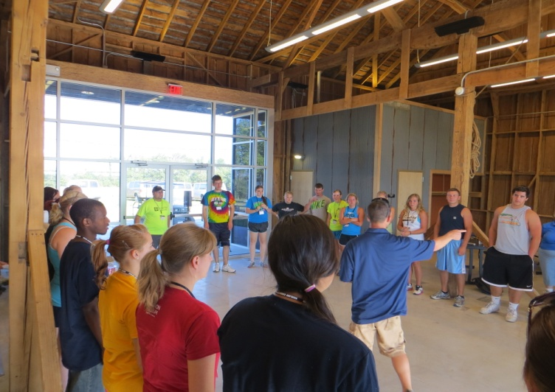
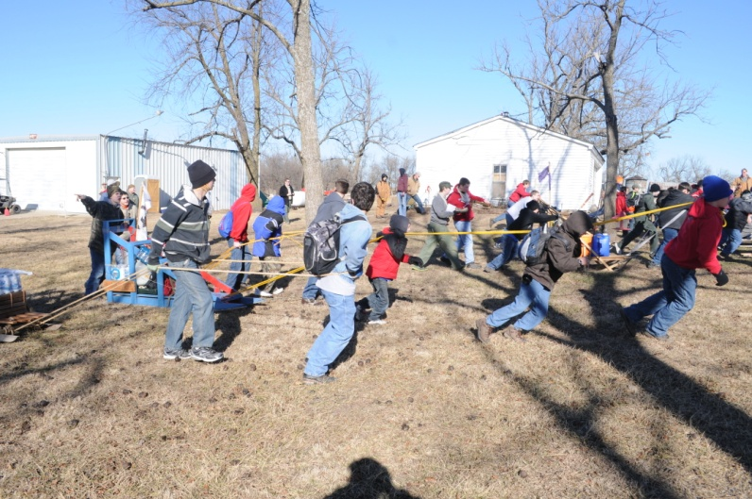
FARM ACTIVITIES
Brown Co. Healthy Foods Coalition
Boy Scout Muzzleloader Demo
2013 BSA Kanza District
Klondike Derby
2012 Student Leader Camp

Slide 19
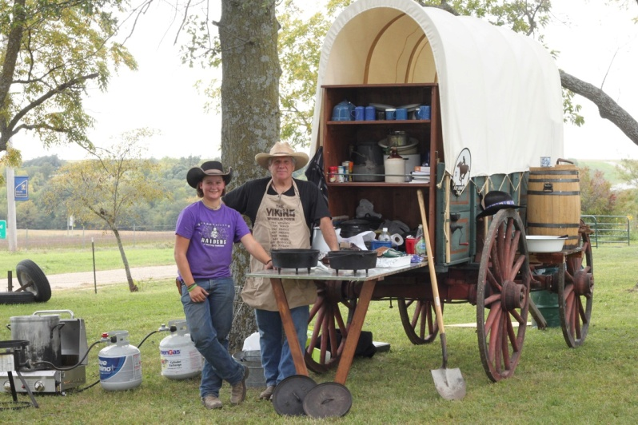
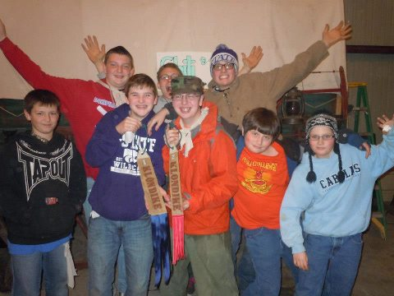
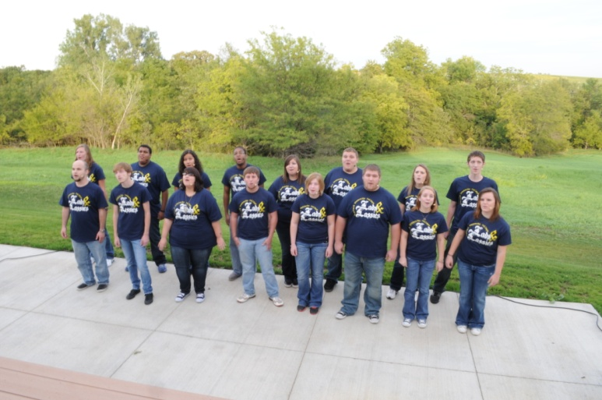
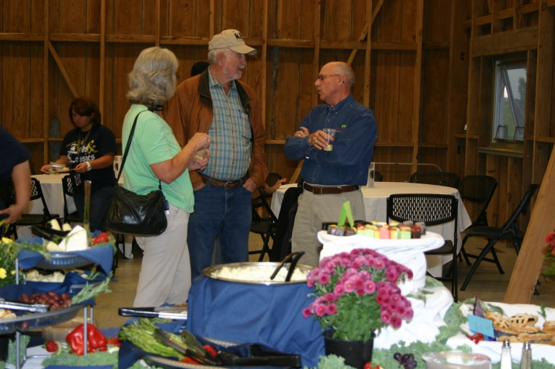
FARM ACTIVITIES
Chuck Wagon Cooking
Klondike Derby Winners
Lads & Lassies Perform
Open House at the Barn

Slide 20
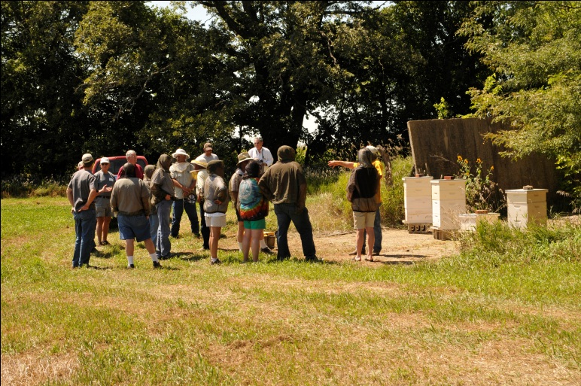
FARM ACTIVITIES
Bee Aware Workshop
Boy Scout Fall Camporee
Scottie Dash ‘12
Scottie Dash ‘12

Slide 21
TRAILS

Slide 22
Seasons

Slide 23
ROPES COURSE

Slide 24
RESEARCH PLOTS
Hidatsa
beans
Mandan
summer
squash
Arikara
water-
melon
Mandan
sweet
corn
Land Institute Staff
Native American
heirloom seed garden
Land Institute plants
KSU corn & soybean plots

Slide 25
FARM STAFF
WENDELL GANSTROM
Farm Projects Manager

Slide 26
FARM STAFF
LINDSEY KOCH
Farm Assistant

Slide 27
We hope you enjoyed this tour of the Klinefelter Farm. We at Highland Community college invite you to come visit the farm and see all of our projects first hand. For more information about the farm or use of the Barn Conference Center, call Eileen Gronniger at 785-442-6010 or Wendell Ganstrom at 785-741-2829.
HCC would like to be “your” community college, and we invite you to be a part of the HCC family.

